Slide 1
DevExpress WinForm
GVHD : Thầy Bùi Tấn Lộc
Thầy Phạm Minh Tuấn

Slide 2







Features
Full Visual studio Integration
Appearance Customization
Faster and More efficiency,security
Rich Client-Side Functionality
Cient-side Events
Binding Data
Template

Slide 3
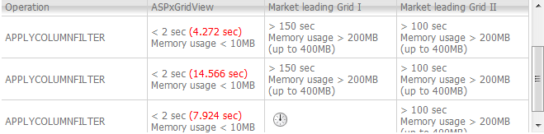
Hiệu năng của DevExpress

Slide 4








Control Suite
A
A
Xtra GridView
Xtra PivotGrid
Xtra Bar
Xtra Layout
Xtra NavBar
Xtra Treelist
Xtra Scheduler
Skin Editor

Slide 5
Features
Full Ado+
LinQ
20 Data Editor
Xtra GridView
Card to View
Layout

Slide 6
Control Suite
A
A
Xtra GridView
Xtra PivotGrid
Xtra Bar
Xtra Layout
Xtra NavBar
Xtra Treelist
Xtra Scheduler
Skin Editor

Slide 7
XtraBars ‘s Features
1
2
3
Support for the Microsoft® Office 2007 Ribbon Interface
Full support of MS Office 2000, Windows XP, OfficeXP and Office 2003 paint schemes.
Support for customizing the layout of bars by end users. XtraBars allows you to enable "hot" customization.

Slide 8
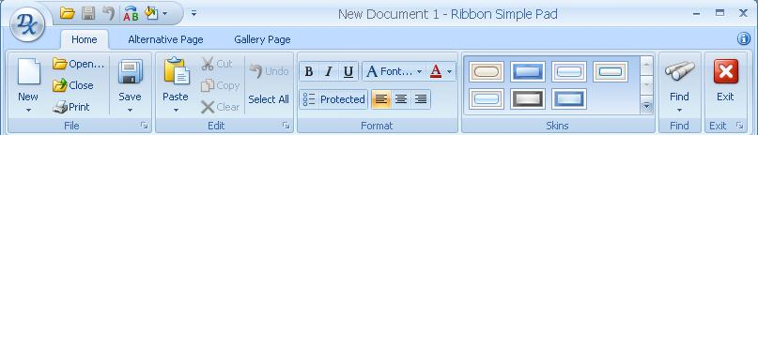
XtraBar’s Screen Shots
Ripboon Page
Ribbon Group
Đổi skin

Slide 9
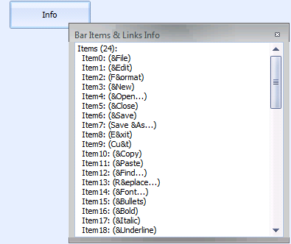
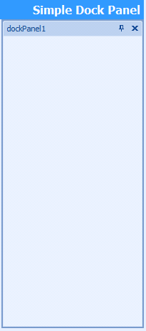
XtraBar’s Screen Shots
Dock Panel
Bar Context

Slide 10
Control Suite
A
A
Xtra GridView
Xtra PivotGrid
Xtra Bar
Xtra Layout
Xtra NavBar
Xtra Treelist
Xtra Scheduler
Skin Editor

Slide 11
XtraTreeList ‘s Features
1
2
3
8 new filter conditions BeginsWith
EndsWith
Contains
NotContains
Like
NotLike
IsBlank
IsNotBlank
Animation :
Support for animated GIF files when using the ImageEdit and PictureEdit controls for in-place editing.
Support for data editing in the TreeList control when binding to a business object

Slide 12
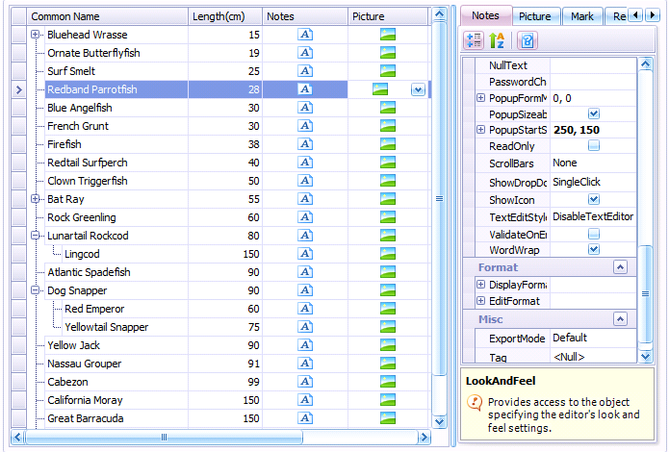
XtraTreeList ‘s Screen Shots

Slide 13
Control Suite
A
A
Xtra GridView
Xtra PivotGrid
Xtra Bar
Xtra Layout
Xtra NavBar
Xtra Treelist
Xtra Scheduler
Skin Editor

Slide 14
XtraScheduler ‘s Features
1
2
3
Built-In Date Views (5 in All):
O Day View
O Work Week View
O Week View
O Month View (Multi-Week View)
O Timeline View
Date Navigator Control:
O Today button
O Week numbers
O Bold dates with appointments
O Multiselect
O Holidays highlighting
Multiple Resources Display:
O Group by date
O Group by resource
O Resource images
O Resource filtering
O Resource scrolling
O Resource sharing

Slide 15
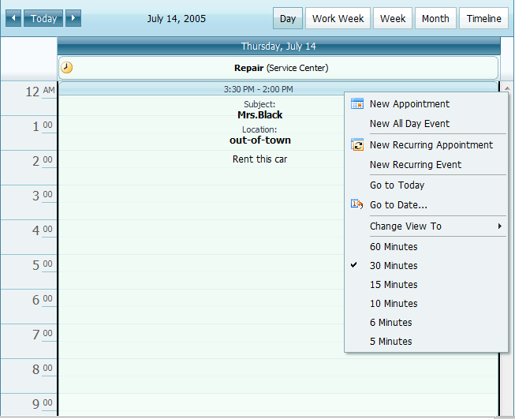
XtraScheduler ‘s Screen Shots

Slide 16
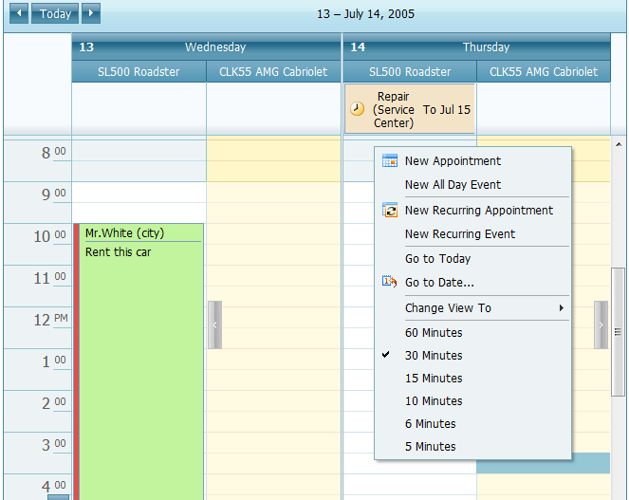
XtraScheduler ‘s Screen Shots

Slide 17
Control Suite
A
A
Xtra GridView
Xtra PivotGrid
Xtra Bar
Xtra Layout
Xtra NavBar
Xtra Treelist
Xtra Scheduler
Skin Editor

Slide 18
Xtra PrivotGrid ‘s Features
1
2
3
Support for multiple data source types :
O Full support for ADO+
O Custom data sources
Automatic summary calculation for each cell :
O There are 9 summary functions available
MS Analysis Services Support:
O Use MS Analysis Services (OLAP) as a data source for the PivotGridControl.

Slide 19
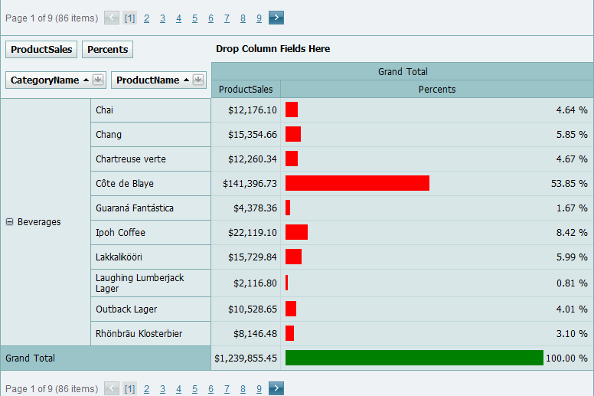
Xtra PrivotGrid ‘s Screen Shots

Slide 20
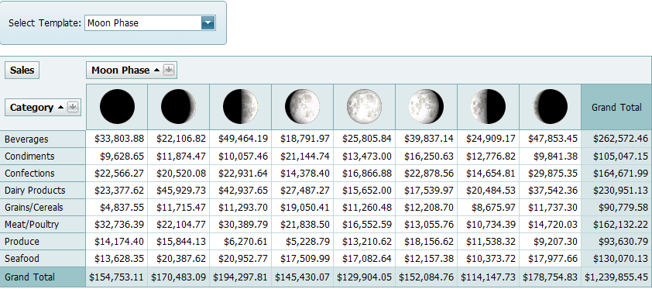
Xtra PrivotGrid ‘s Screen Shots

Slide 21
Control Suite
A
A
Xtra GridView
Xtra PivotGrid
Xtra Bar
Xtra Layout
Xtra NavBar
Xtra Treelist
Xtra Scheduler
Skin Editor

Slide 22
Xtra Layout ‘s Features
1
2
3
Hỗ trợ thay thế các control của winform
Việc thay đổi skin sẽ rất dễ dàng
Support for the Microsoft® Office 2007 ,Look and Feel
Có một hệ thống Interface hỗ trợ việc lập trình rất dễ dàng

Slide 23
Control Suite
A
A
Xtra GridView
Xtra PivotGrid
Xtra Bar
Xtra Layout
Xtra NavBar
Xtra Treelist
Xtra Scheduler
Skin Editor

Slide 24
Control Suite
A
A
Xtra GridView
Xtra PivotGrid
Xtra Bar
Xtra Layout
Xtra NavBar
Xtra Treelist
Xtra Scheduler
Skin Editor

Slide 25
Xtra NavBar ‘s Features
1
2
3
Side Bars
The eight Side Bar paint styles allow you to emulate Outlook 2000, XP, Microsoft Visual Studio .NET
Explorer Bars
The four unique Explorer Bar paint styles :
Emulate Classic Windows
Windows XP Explorer Bar
Microsoft Office 2003 Navigation Pane
style supports all the features introduced in MS Outlook

Slide 26
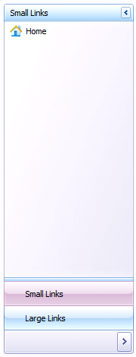
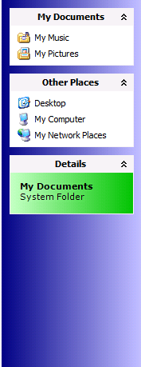
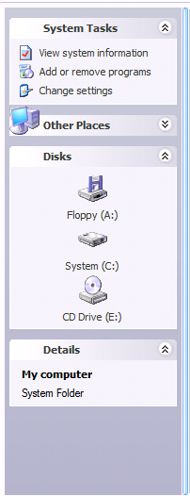
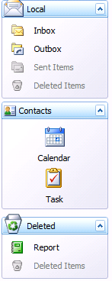
Xtra NavBar ‘s SceenShots
Side Bar
Explorer NavBar
Explorer NavBar
Navigate Panel

Slide 27
Control Suite
A
A
Xtra GridView
Xtra PivotGrid
Xtra Bar
Xtra Layout
Xtra NavBar
Xtra Treelist
Xtra Scheduler
Skin Editor

Slide 28
Thank You !
www.themegallery.com

